Slide 1
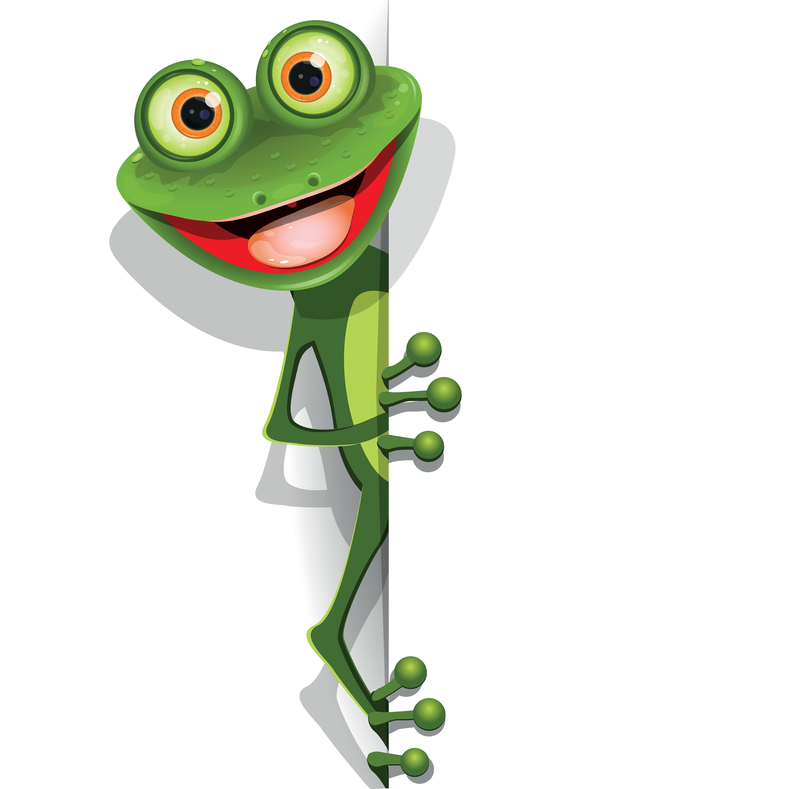
This is the stage in the writing process where you fix up your mistakes.
Editing-
Created by Leanne Williamson, adapted from Steph Westwood’s work 2017

Slide 2
Capital letters
The first word in every sentence.
My teacher is a girl.
Check that you have capital letters in all the right spots.
Proper Nouns- the names of people, places, things.
Stephanie saw Mr Pope at Macarthur Square on Saturday.
When ‘I’ is by itself.
Emma and I went to the shops.
Created by Leanne Williamson, adapted from Steph Westwood’s work 2017

Slide 3
Spelling-
Circle the words which you do not think are spelt correctly.
I whent to the shops to buy some milk.
Check that your spelling looks right.
Check and correct your spelling by using a dictionary or the word wall.
went
I whent to the shops to buy some milk.
Created by Leanne Williamson, adapted from Steph Westwood’s work 2017

Slide 4
Punctuation-
Does every sentence end with the correct punctuation mark?
Check that your sentences have been punctuated correctly.
Question Marks ? – are used at the end of sentences asking questions
Did you finish your work?
Full Stop . – are used at the end of a telling sentence
I go to school.
Created by Leanne Williamson, adapted from Steph Westwood’s work 2017

Slide 5
Punctuation continued-
Exclamation Marks ! – are used at the ends of telling sentences that show surprise or excitement. Look out!
Check that your sentences have been punctuated correctly.
Commas, – are used to separate words in a list. Mrs Williamson bought some lollies, rubbers, pencils, skipping ropes and bubbles for her surprise box.
Speech Marks “ “ – go around words to show what someone is saying.
“Bring me your book,” said Miss Moisy.
Created by Leanne Williamson, adapted from Steph Westwood’s work 2017

